Slide 1

6th Grade Math
Unit 4, Lesson 11 Interpreting and Comparing Absolute Values in the Real World Volume 1, pg. 188

Slide 2


Benchmark
MA.6.NSO.1.4
Solve mathematical and real-world problems involving absolute value, including the comparison of absolute value.
volume 1, pg. 188

Slide 3
Integrated Mathematical Thinking and Reasoning Standards
MA.K12.MTR.4.1 Engage in discussions that reflect on the mathematical thinking of self and others.
MA.K12.MTR.7.1 Apply mathematics to real-world contexts.
volume 1, pg. 188

Slide 4

Learning Target
I can compare the absolute value of two numbers in a real-world context.
volume 1, pg. 188

Slide 5

Warm-Up
volume 1, pg. 188

Slide 6
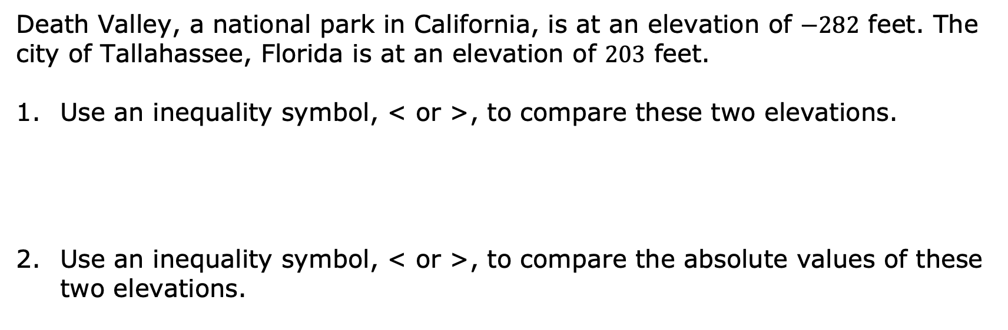
4.11.1 Warm-Up: Absolute Elevations
Death Valley, a national park in California, is at an elevation of $−282$ feet. The city of Tallahassee, Florida is at an elevation of $203$ feet.
Use an inequality symbol, < or >, to compare these two elevations.
Use an inequality symbol, < or >, to compare the absolute values of these two elevations.
volume 1, pg. 188

Slide 7
Explain what these two inequality statements mean in terms of the elevations of Death Valley and Tallahassee.
volume 1, pg. 188

Slide 8

Guided Instruction
volume 1, pg. 189

Slide 9
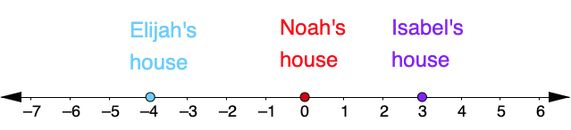
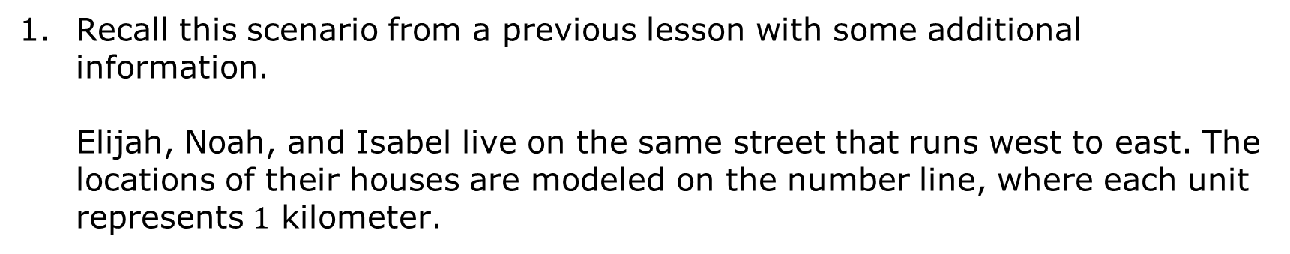
4.11.2 Guided Instruction: Comparing and Interpreting Absolute Value in Context
Recall this scenario from a previous lesson with some additional information.
Elijah, Noah, and Isabel live on the same street that runs west to east. The locations of their houses are modeled on the number line, where each unit represents $1$ kilometer.
WEST
EAST
volume 1, pg. 189

Slide 10
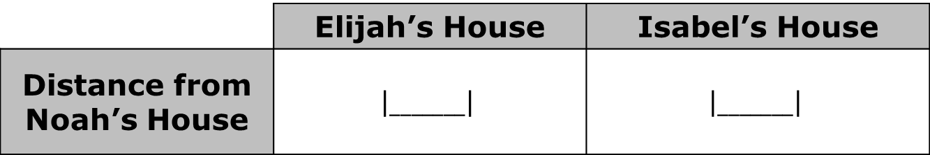

WEST
EAST
Noah’s house is located at $0$ on the number line model. Represent the distance from Noah’s house to both Isabel’s house and Elijah’s house using absolute value.
How do the absolute values in the table compare to each other?
$$\left|______\right|>\left|______\right|$$
 | Elijah’s House | Isabel’s House
Distance from Noah’s House | $$\left|_______\right|$$ | $$\left|_______\right|$$
volume 1, pg. 189

Slide 11
WEST
EAST
east
west
Isabel lives _____ kilometers to the of
Noah. Elijah lives ______ kilometers to the
of Noah. Isabel lives Noah than
Elijah does.
east
west
closer to
farther from
volume 1, pg. 189

Slide 12
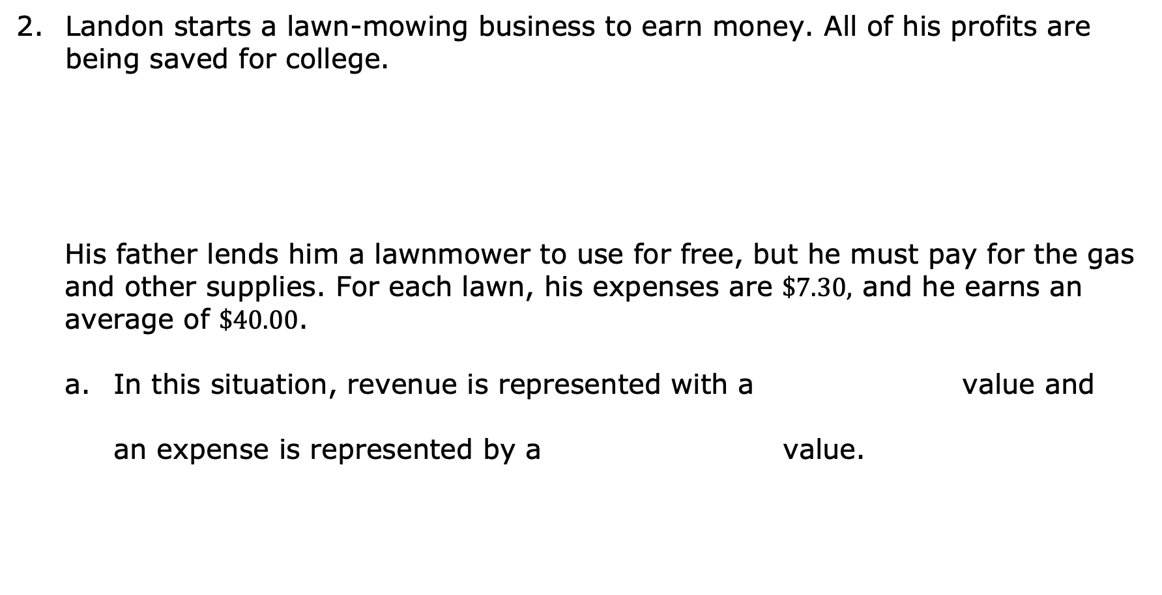
Landon starts a lawn-mowing business to earn money. All of his profits are being saved for college.
His father lends him a lawnmower to use for free, but he must pay for the gas and other supplies. For each lawn, his expenses are $\$7.30,$ and he earns an average of $\$40.00$.
In this situation, revenue is represented with a value and
an expense is represented by a value.
Profit is the difference between the amount earned (revenue) and the amount spent.
positive
negative
positive
negative
volume 1, pg. 189

Slide 13

Write a value to represent each situation.
Use an inequality symbol, < or >, to compare the absolute values of Landon’s expenses to revenue for each lawn he mows.
$$\left|________\right|>\left|________\right|$$
Landon’s Finances | Value
Expenses per lawn
Revenue per lawn
volume 1, pg. 189

Slide 14
How does the inequality show that Landon will make a profit?
To make a profit, total expenses of a business must be total
revenue. A business is not profitable when the total
greater than the
greater than
less than
expenses are
revenue is
expenses.
revenue.
volume 1, pg. 190

Slide 15

Collaboration
volume 1, pg. 190

Slide 16

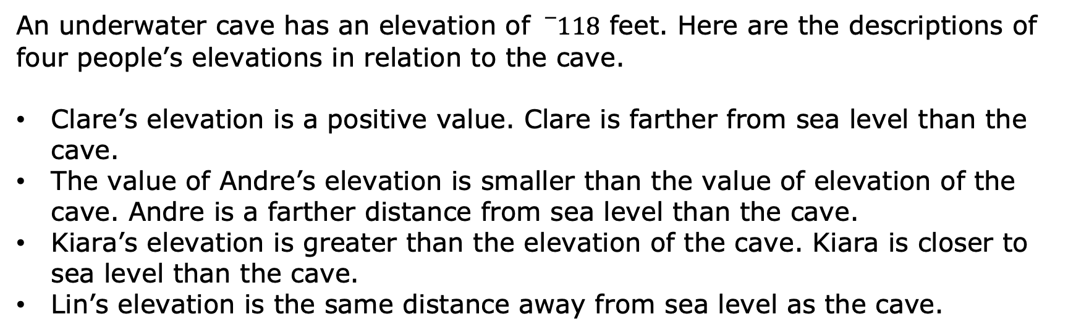
4.11.3 Collaboration: Exploring Additional Contexts
An underwater cave has an elevation of ${}_{}^{−}{118}$ feet. Here are the descriptions of four people’s elevations in relation to the cave.
Clare’s elevation is a positive value. Clare is farther from sea level than the cave.
The value of Andre’s elevation is smaller than the value of elevation of the cave. Andre is a farther distance from sea level than the cave.
Kiara’s elevation is greater than the elevation of the cave. Kiara is closer to sea level than the cave.
Lin’s elevation is the same distance away from sea level as the cave.
volume 1, pg. 190

Slide 17
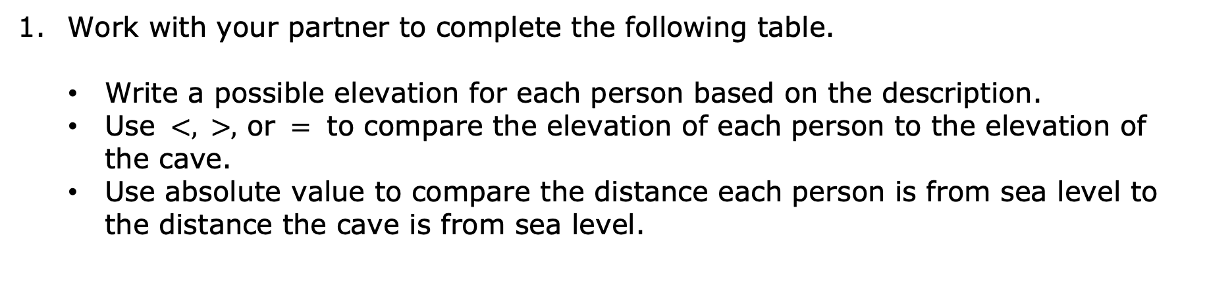
Work with your partner to complete the following table.
Write a possible elevation for each person based on the description.
Use $<, >,$ or $=$ to compare the elevation of each person to the elevation of the cave.
Use absolute value to compare the distance each person is from sea level to the distance the cave is from sea level.
volume 1, pg. 190

Slide 18
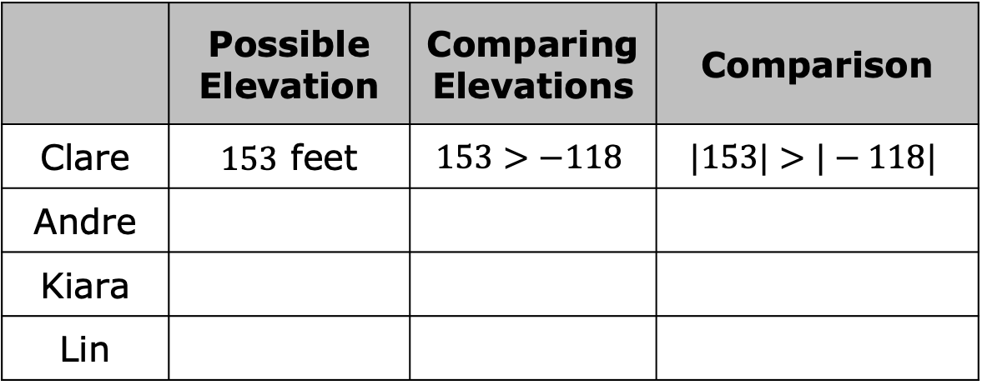
The first row has been completed for Clare.
 | Possible Elevation | Comparing Elevations | Comparison
Clare | $153$ feet | $$153>−118$$ | $$|153|>|−118|$$
Andre
Kiara
Lin
volume 1, pg. 190

Slide 19
Priya says her elevation is less than the cave’s and she is closer to sea level. Is this possible? Explain your reasoning or draw a picture.
volume 1, pg. 191

Slide 20

Your Turn
volume 1, pg. 191

Slide 21
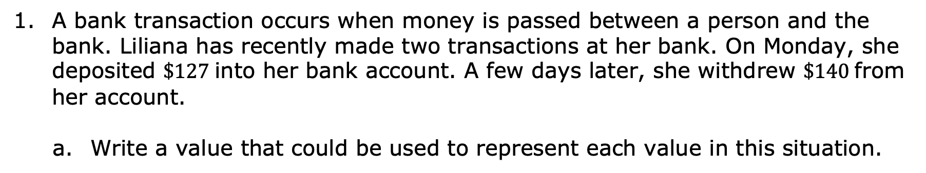
4.11.4 Your Turn!
A bank transaction occurs when money is passed between a person and the bank. Liliana has recently made two transactions at her bank. On Monday, she deposited $\$127$ into her bank account. A few days later, she withdrew $\$140$ from her account.
Write a value that could be used to represent each value in this situation.
Liliana’s Bank Transaction | Value
Deposit
Withdrawal
volume 1, pg. 191

Slide 22
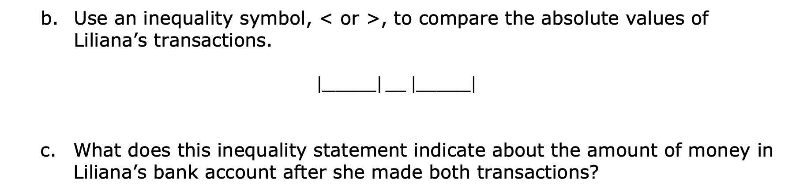
Use an inequality symbol, < or >, to compare the absolute values of Liliana’s transactions.
$\left|________\right|$ ___ $\left|________\right|$
What does this inequality statement indicate about the amount of money in Liliana’s bank account after she made both transactions?
volume 1, pg. 191

Slide 23
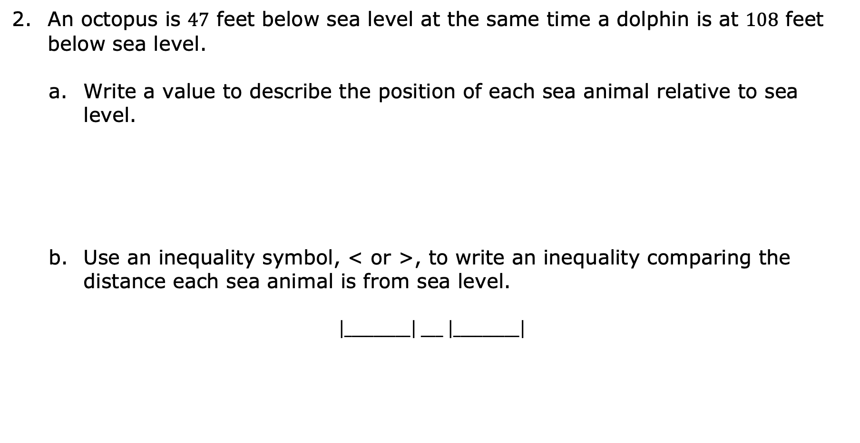
An octopus is 47 feet below sea level at the same time a dolphin is at 108 feet below sea level.
Write a value to describe the position of each sea animal relative to sea level.
Use an inequality symbol, < or >, to write an inequality comparing the distance each sea animal is from sea level.
$\left|_________\right|$ ___ $\left|_________\right|$
Octopus | Dolphin
volume 1, pg. 192

Slide 24
What does this inequality statement indicate about the locations of each sea animal?
volume 1, pg. 192

Slide 25

Wrap-Up
volume 1, pg. 192

Slide 26
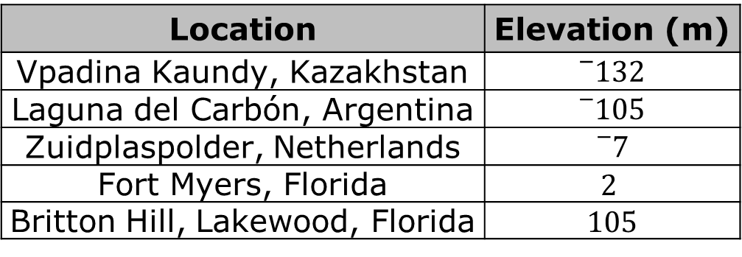
4.11.5 Wrap-Up: Ticket Out the Door
The table shows the elevation, in meters (m), of five locations.
Location | Elevation (m)
Vpadina Kaundy, Kazakhstan | $${}_{}^{−}{132}$$
Laguna del Carbón, Argentina | $${}_{}^{−}{105}$$
Zuidplaspolder, Netherlands | $${}_{}^{−}7$$
Fort Myers, Florida | $$2$$
Britton Hill, Lakewood, Florida | 105
volume 1, pg. 192

Slide 27
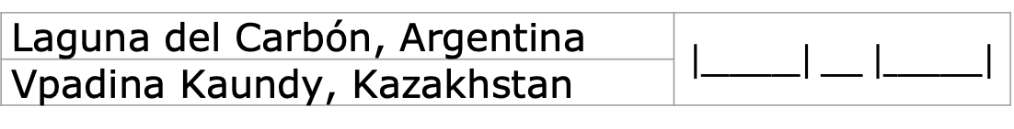
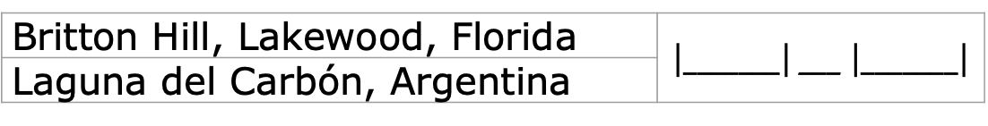
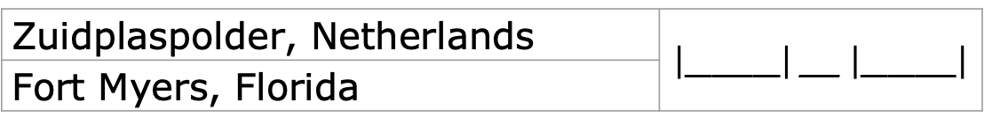
For each pair, use $< , > ,$ or $=$ to compare their distances from sea level.
Zuidplaspolder, Netherlands | $\left|_______\right|$ ___ $\left|_______\right|$
Fort Myers, Florida
Britton Hill, Lakewood, Florida | $\left|_______\right|$ ___ $\left|_______\right|$
Laguna del Carbón, Argentina
Laguna del Carbón, Argentina | $\left|_______\right|$ ___ $\left|_______\right|$
Vpadina Kaundy, Kazakhstan
volume 1, pg. 192

